Slide 1
Data visualization
Taylor Dunivin
EDAMAME
July 26, 2018

Slide 2
Why R?
free
open-source
designed for data analysis and statistics
user-community
highly extensible
easy organization with RStudio

Slide 3
RStudio

Slide 4
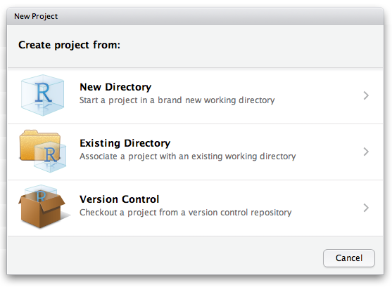
Organization in Rstudio (Projects)
File → New Project

Slide 5
Organization in Rstudio (Projects)
File → New Project
What’s included in an R Project?
.Rproj extension
Self-contained home for
code
data
output
figures
.gitignore
Working directory = project directory

